Slide 1

A Brief Exploration of FEMA Data
Rutger’s Data science bootcamp
By: flomo kokro, Meghna agnish, Bhargav andipara, Paul kazalski

Slide 2
Outline
Introduction
Working with primary sources.
The data exploration and clean up process.
The analysis process.
API’s
Disasters
Possible Implications/Conclusion

Slide 3



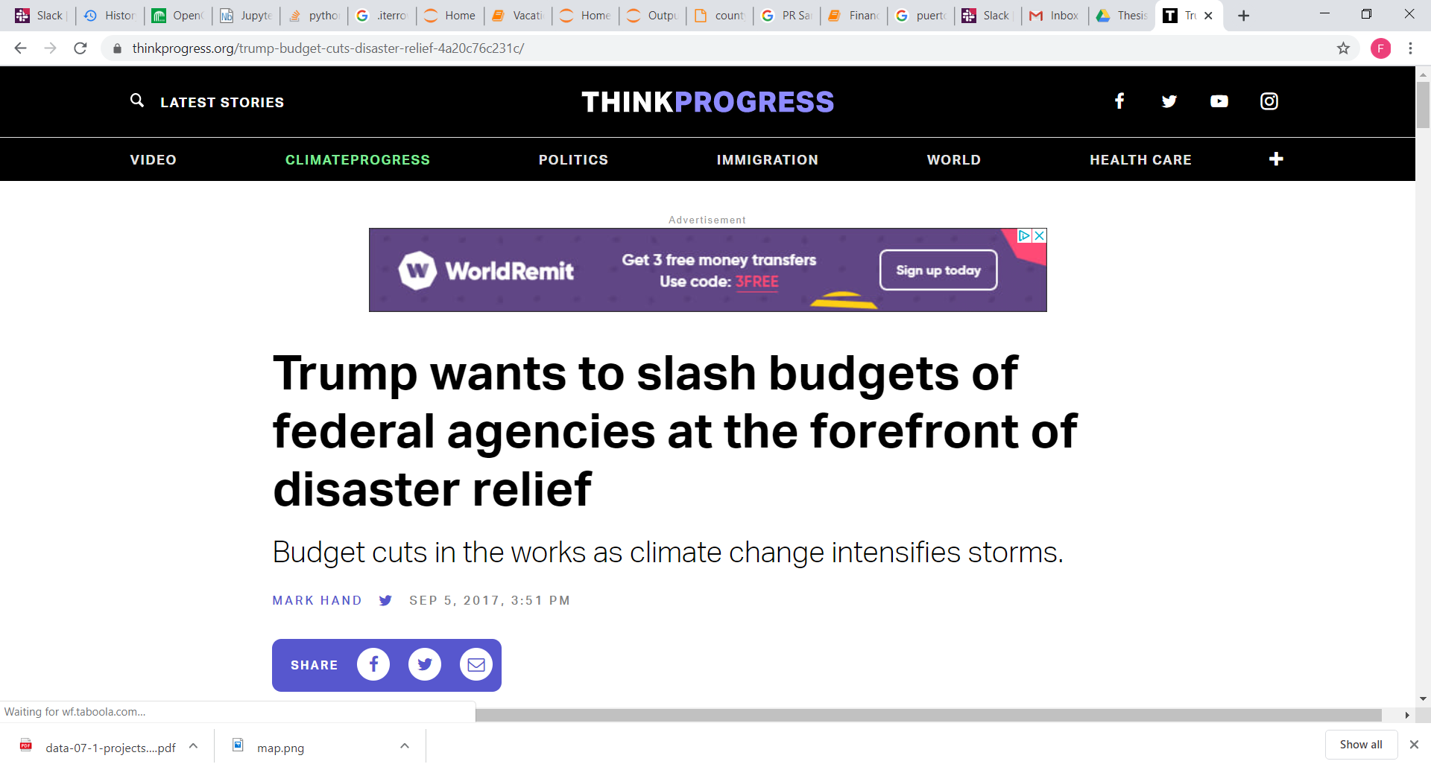

Introduction
Climate change trending topic.
Funds seem to be readily available and easily transferable.
How are FEMA funds allocated?
Should FEMA be defunded?

Slide 4
Working with Primary Sources
Sources
Source 1: “Disaster Declarations Summary”. (Date and type of disaster)
Source 2: “FEMA_Housing_Assistance”. (Payout data. Renters and Owners)
This data is based on the individual housing payout (IHP).
Challenges
Sources have different formats. A common index had to be created.
Sources have vastly different datasets. Filters and trims were required.
Zip code data vs county data.

Slide 5

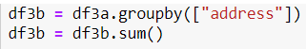
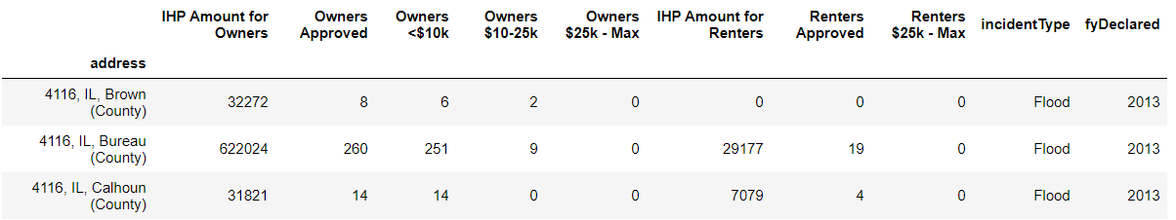
Examples of Data Cleaning
Create the single index from 3 columns
Df of data not summed
Df of data summed

Slide 6
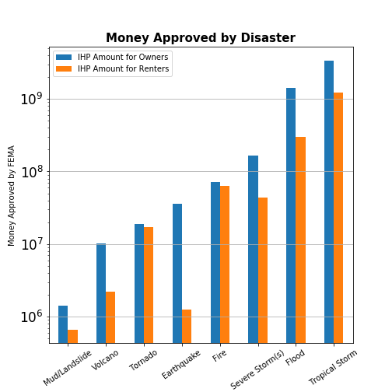
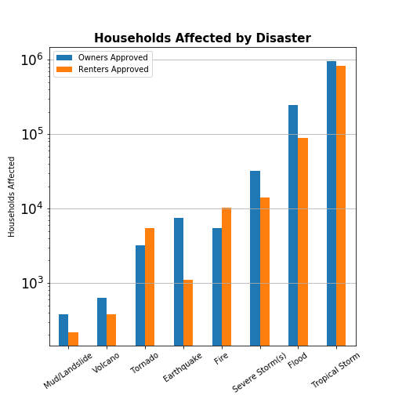
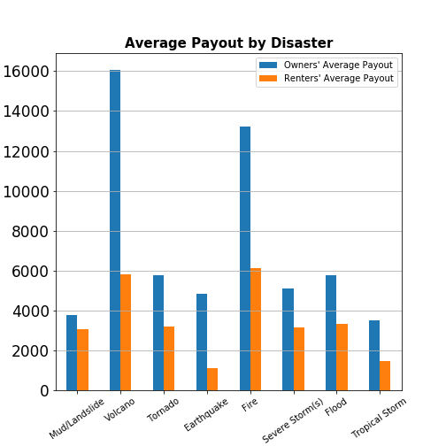
Comparing Payouts by Disaster Type

Slide 7
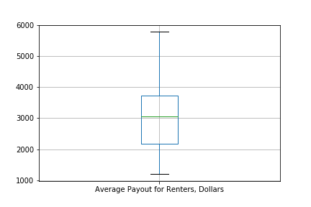
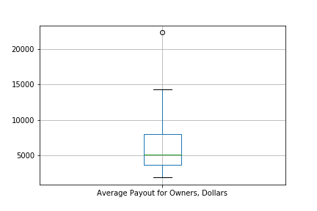
Boxplot of Average Payout by State

Slide 8
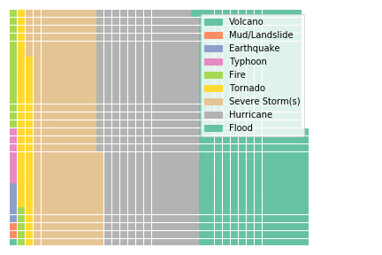
Counties Affected by Disaster Type

Slide 9
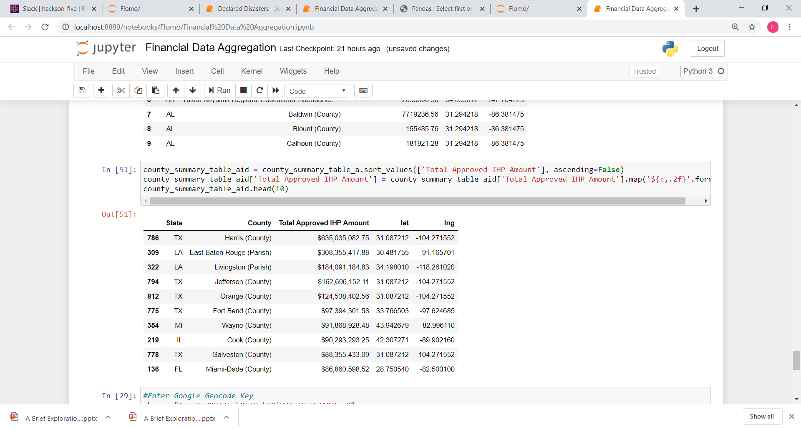
The Analysis Process
What counties and states receive the most FEMA IHP assistance in 2019?

Slide 10
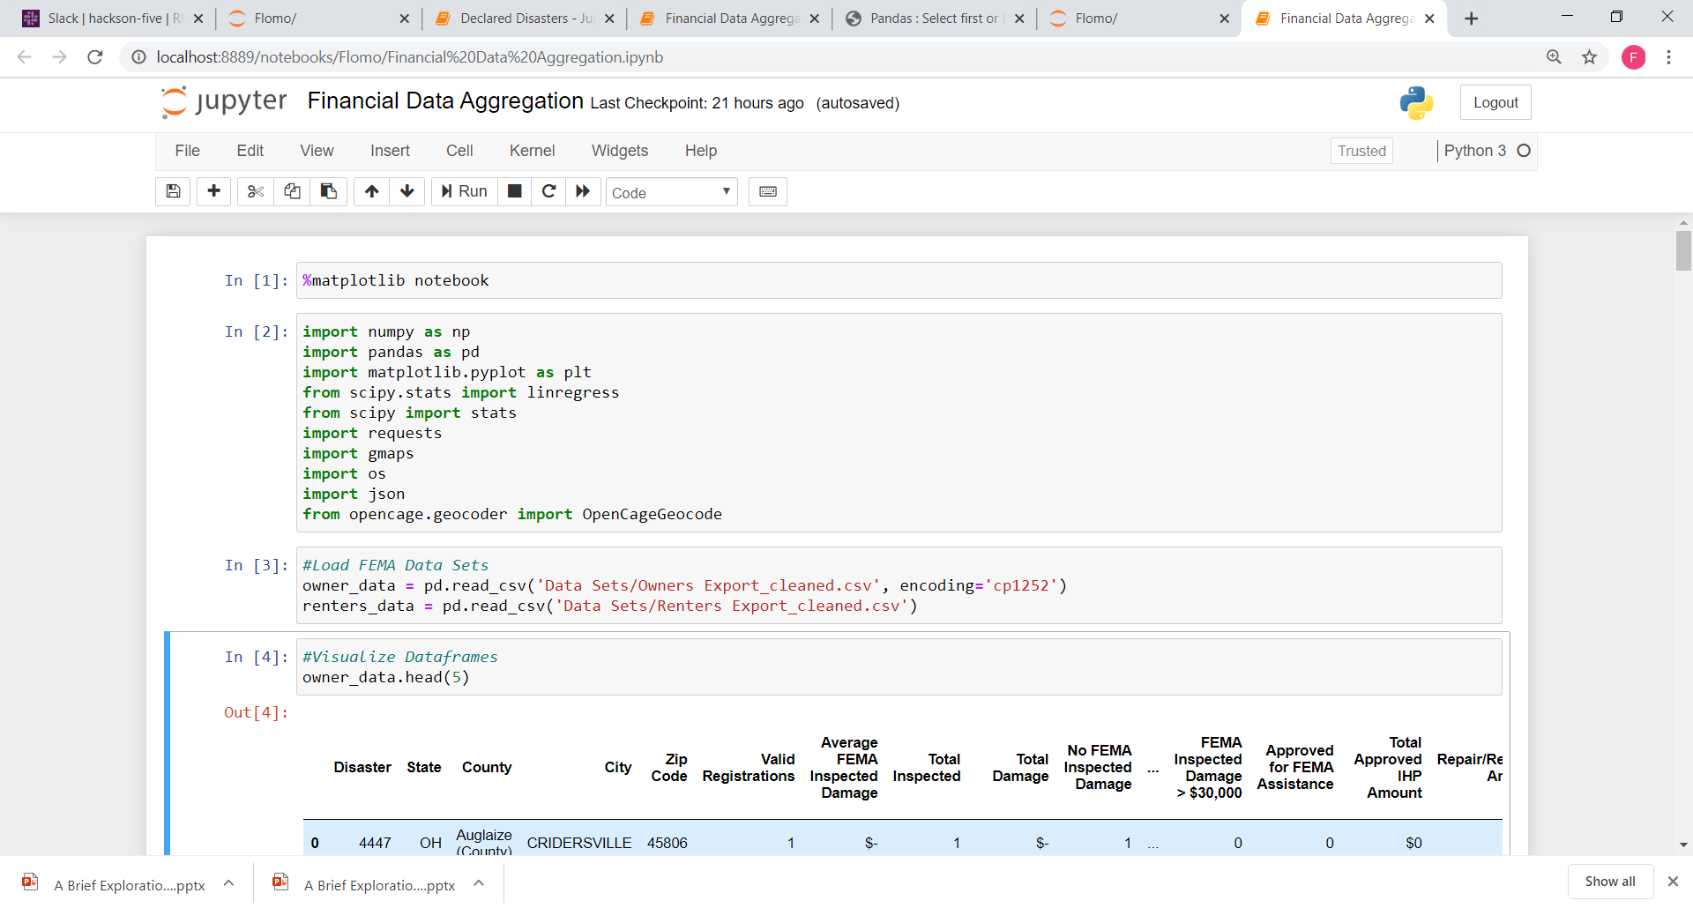
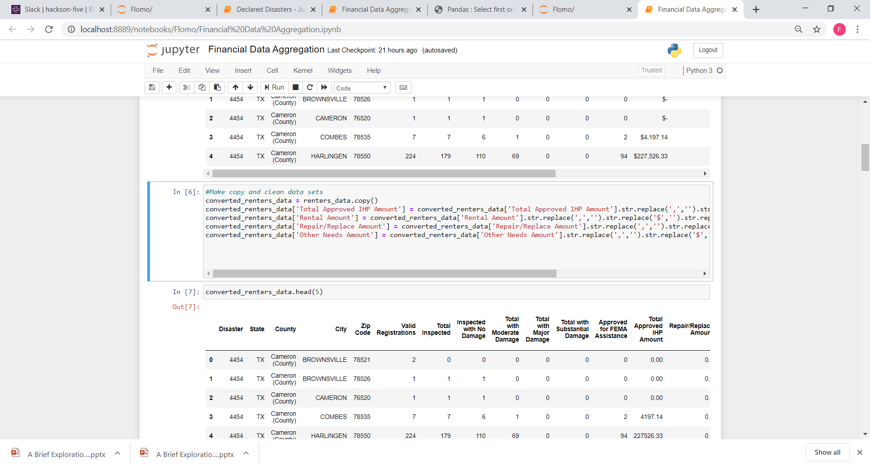
Preparing Data Sets
Data Import – Non ACSII characters
Data Cleaning – Remove Formating, fill empty cells, correct letter or number formats.

Slide 11
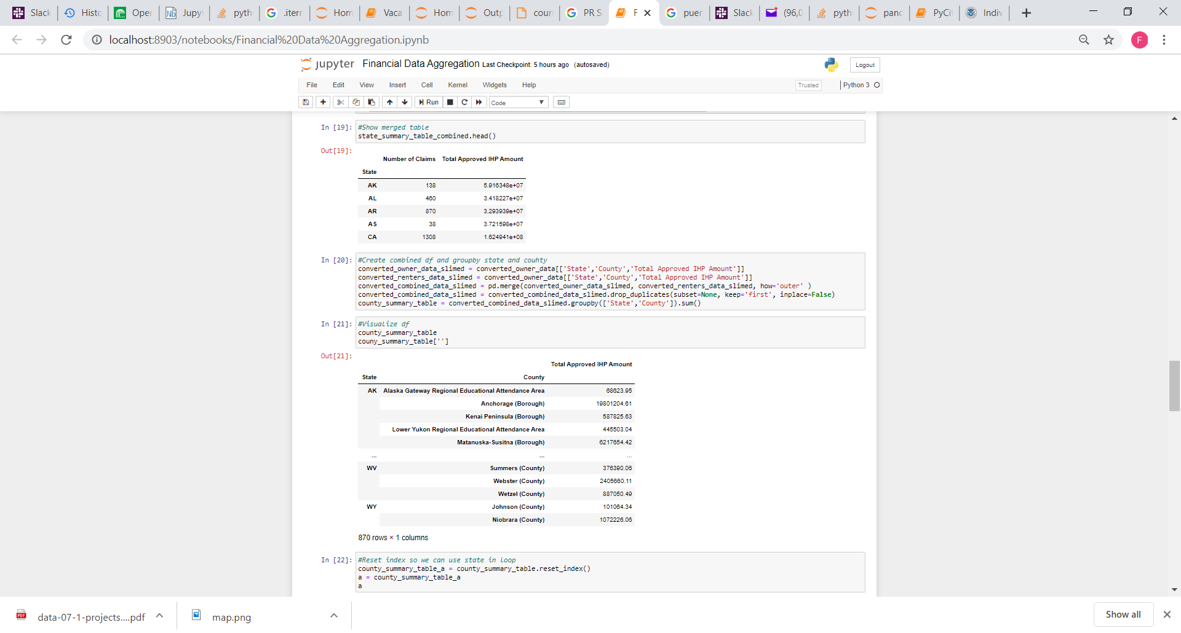
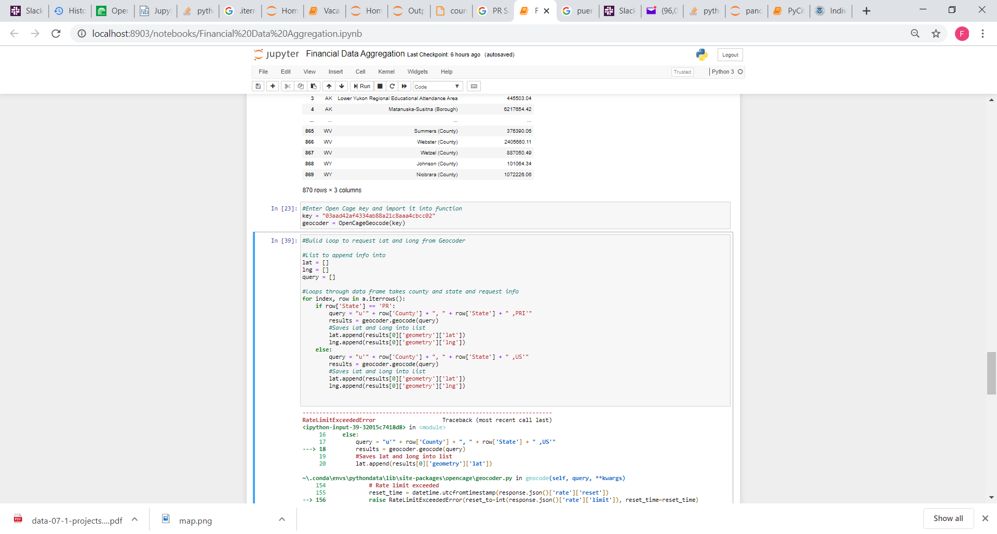
Data Preparation Continues
Use of sum to groupby couny and state
Use Opencage to retrieve latitudes and longitude for each county

Slide 12
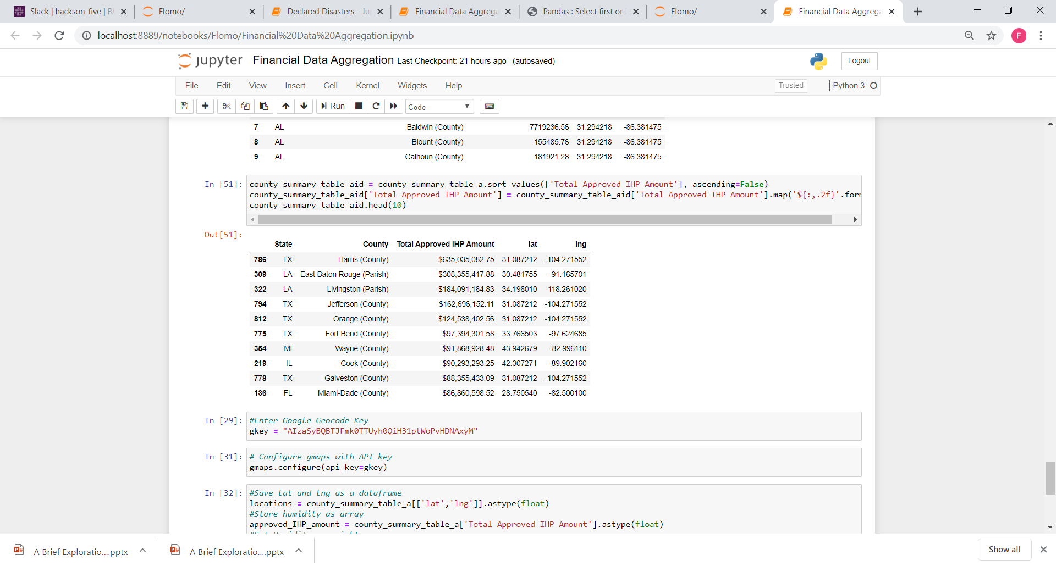
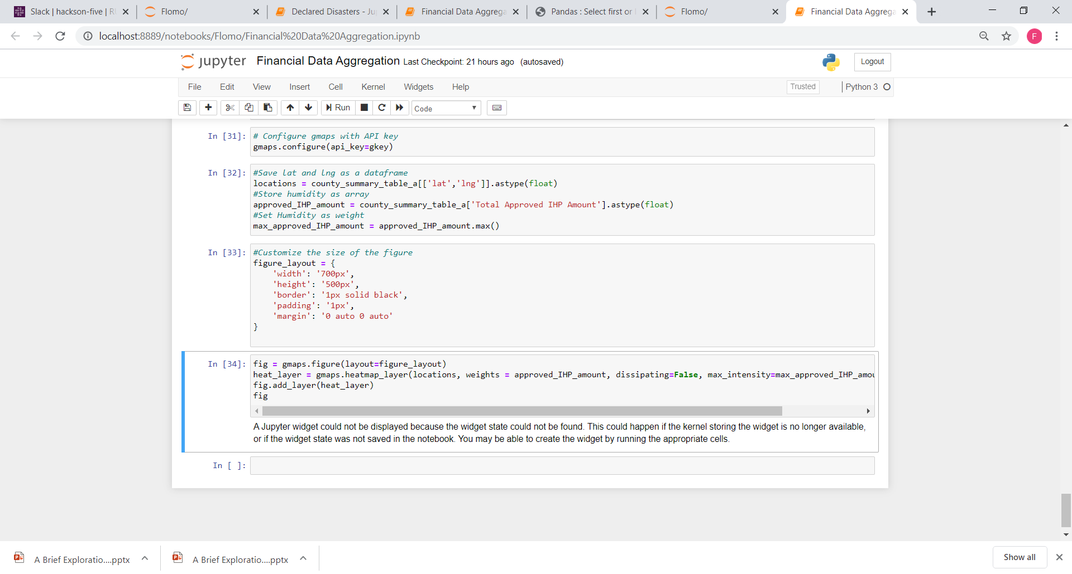
The Analysis Process cont.
Groupby table with lats. and lngs.
Use of API’s to build heat map of counties with highest assistance grant through FEMA’s IHP program.

Slide 13
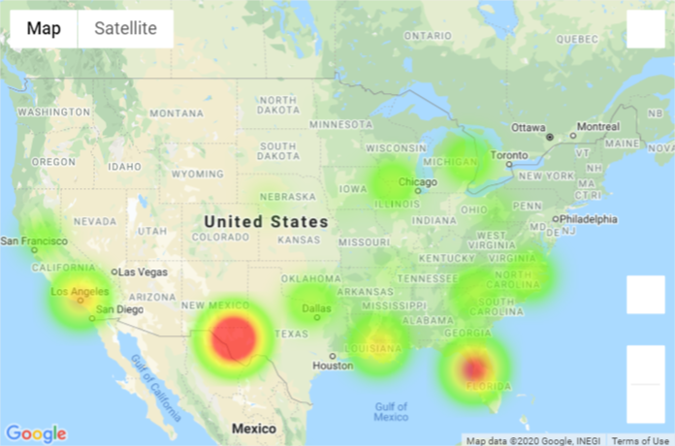
Counties Receiving IHP Assistance
Heat Map – Counties allotted the most funding through FEMA’s IHP program.

Slide 14
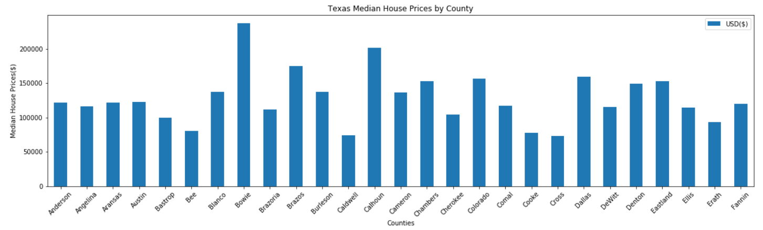
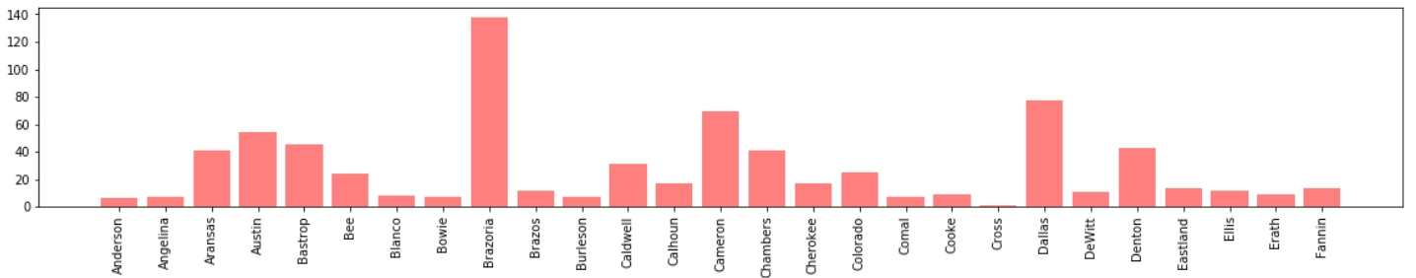
Zillow API’s
Source:
Zillow GetRegionChildren.api
Clean-up: XML→JSON→DataFrame
Analysis:
The Median price of the house is not closely related to the number of disasters in a county.
Counties with Highest Disasters had median house prices around $100k or less.
County with Least Disaster had Least Median House Price.

Slide 15
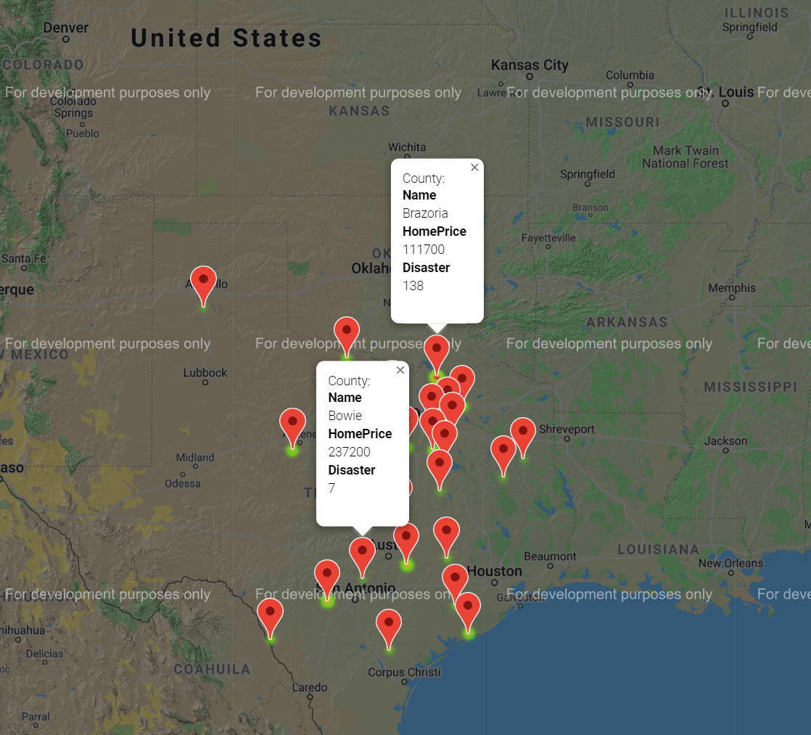
Zillow API’s cont.

Slide 16
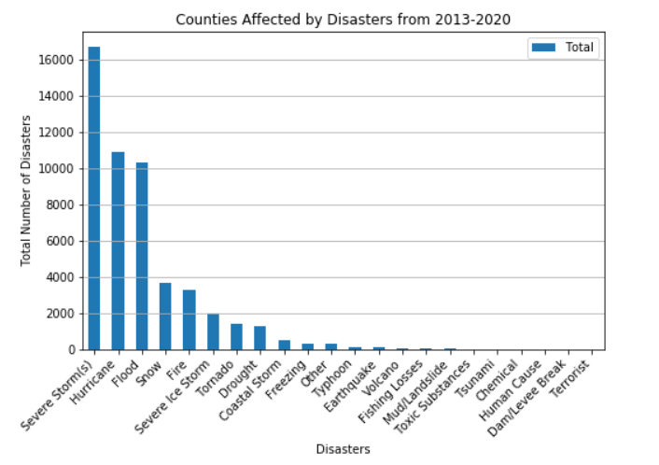
Conclusion: Data Summary and Visualizations

Slide 17
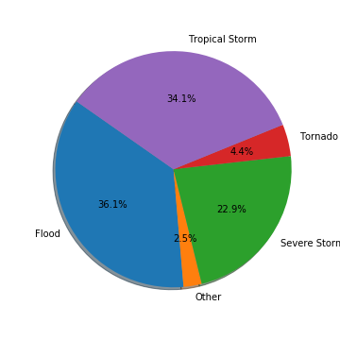
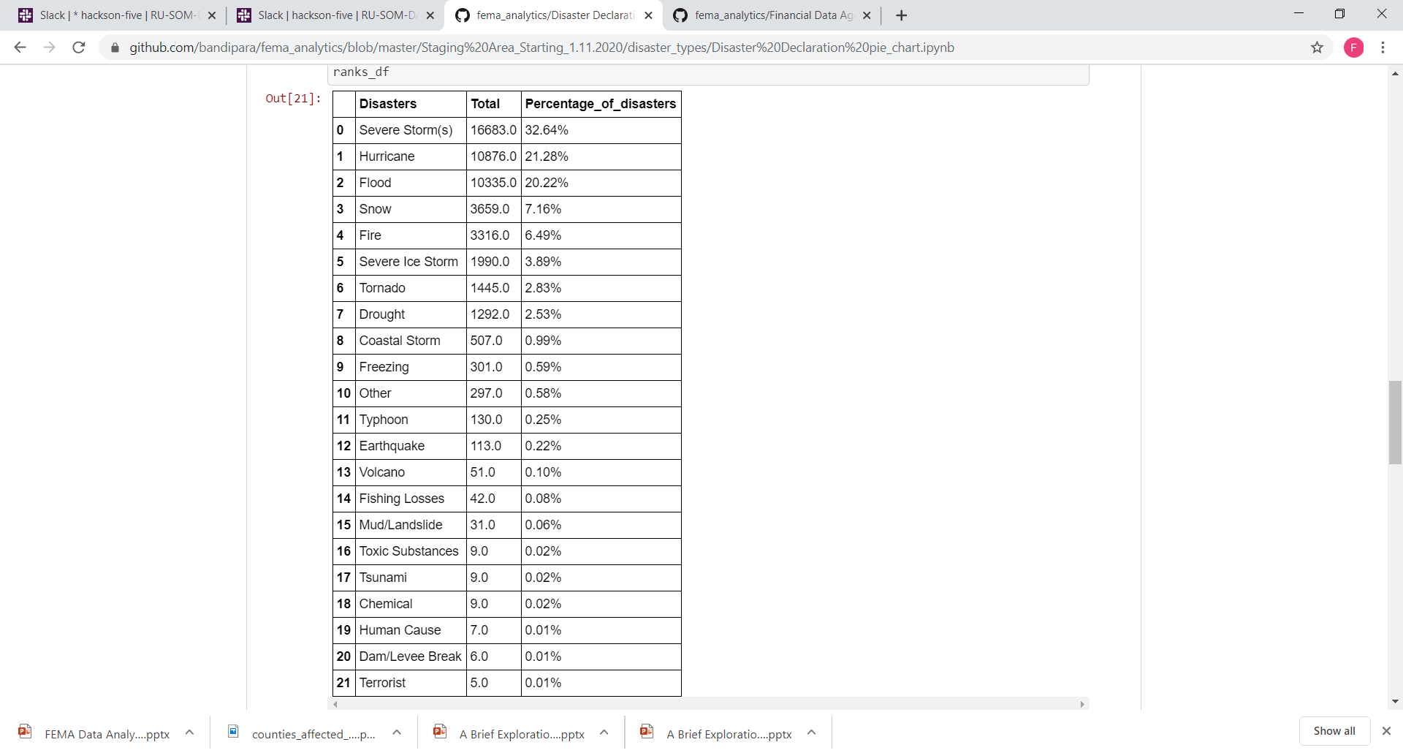
Conclusion: Data Summary and Visualizations

Slide 18
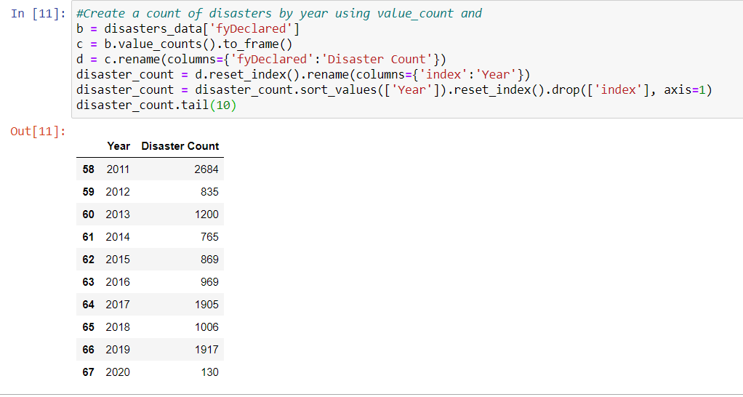
Implications

Slide 19
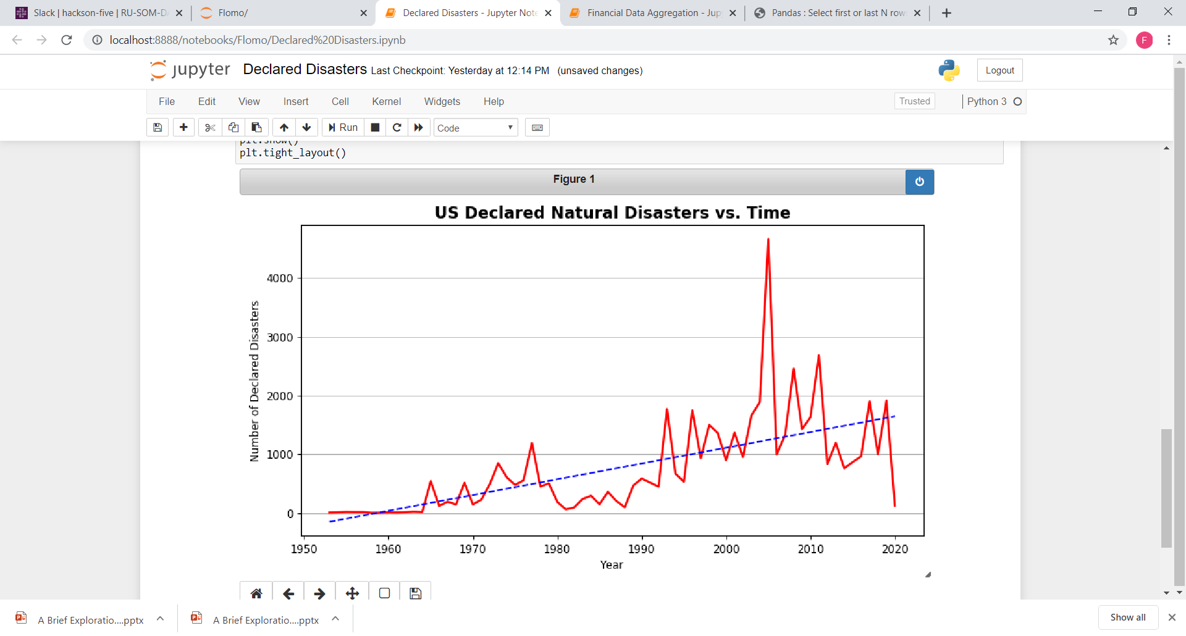
Implications Cont.

Slide 20
Thank You!
Questions?

